Slide 1

Unit-1 Introduction to Operating System
Operating System (OS)
2101CS403
Prof. Firoz A Sherasiya
Computer Engineering Department
firoz.sherasiya@darshan.ac.in
9879879861

Slide 2

Looping
Outline
What is Operating System (OS)
Roles of Operating System (OS)
Objectives / Goals of Operating System (OS)
Generations of Operating Systems (OS)
Operating Systems (OS) services
Types of Operating Systems (OS)
System calls
Operating Systems (OS) structure
Multiprogramming v/s Multiprocessing v/s Multitasking
Time Sharing Operating System
Parallel Processing Operating System
Distributed Operating System

Slide 3
What is Operating System (OS)
Section - 1

Slide 4
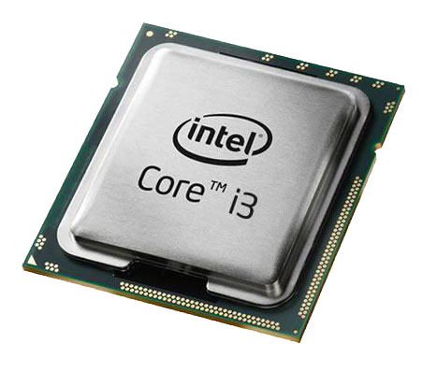
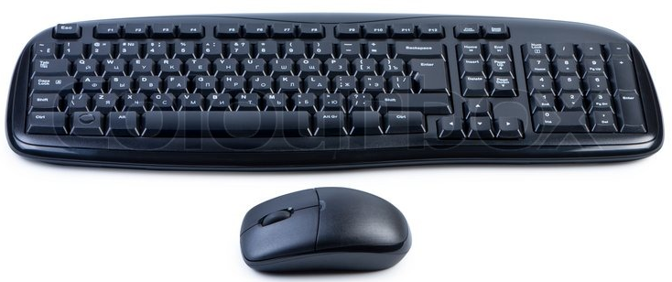
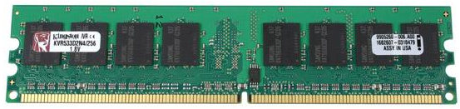
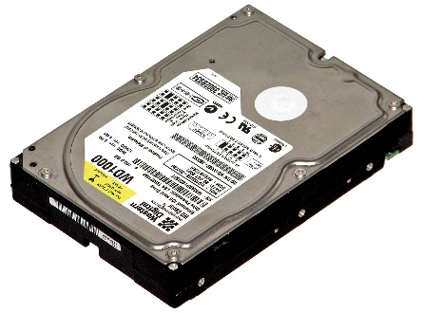

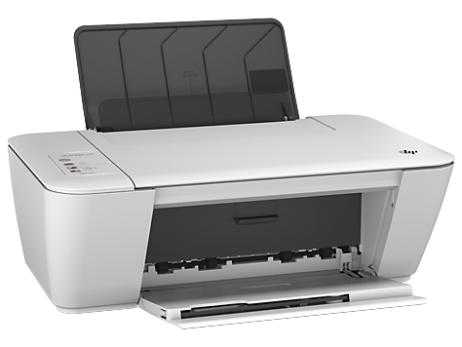
What is Operating System (OS)?
A Computer System consists of various hardware's such as
Processor
RAM
Keyboard & Mouse
Hard Disk
Monitor
Printer
Who manages (controls) these hardwares???
Operating System

Slide 5
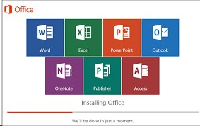
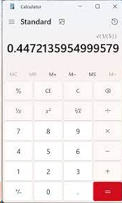
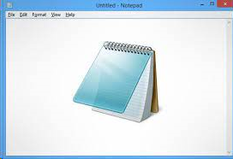

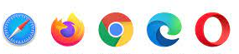
Definition of Operating System (OS)
An Operating System (OS) is a collection of software that
manages hardware resources
provides various service to the users
A program is a piece of code or a set of instructions that performs a given task.
A software is a set of programs used to perform various tasks, which is more complex than that of a program.

Slide 6
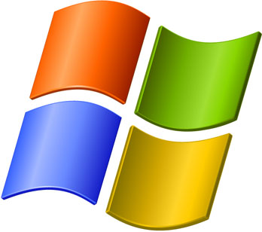
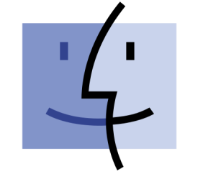




Examples of Operating System (OS)
Windows
Examples
of Operating System
Mac OS
Android
Fedora
Linux
Ubuntu

Slide 7

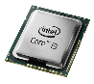
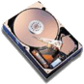

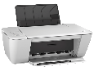
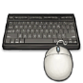
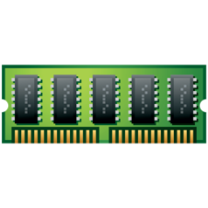
Where OS lies? (Interaction of OS & Hardware)
OS lies between hardware and user program.
It acts as an intermediary between the user and the hardware.
Modes of operation of computer
Kernel Mode
has complete access to all the hardware
can execute any instruction that a machine is capable of executing
has high privileged (rights)
User Mode
has limited access to limited hardware
can execute only subset (few) of the machine instructions
has less privileged (rights)
Web
browser
E-mail
reader
Music
player
User
Mode
User Program
Software
Operating System
Kernel
Mode
Hardware

Slide 8
Why and How switch occur?
Web
browser
E-mail
reader
Music
player
User is writing program in C.
Once finish writing will execute it.
User
Mode
user-mode program
performs trap instruction
User Program
Software
Operating System
Kernel
Mode
To execute this program
Load program into RAM
Program is executed by processor
Hardware

Slide 9
Roles of Operating System (OS)
Section - 2

Slide 10

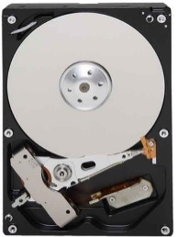

OS as Extended Machine
The architecture of a computer is difficult to program
Architecture (instruction set, memory organization, I/O, bus structure) of most of computer at the machine level language is primitive and awkward to program.
Example: If user want to read from floppy or hard disk:
Mechanical details of the engine, transmission, and other components

Slide 11



OS as Extended Machine
Example: If user want to read from floppy or hard disk:
User has to write command and address to the disk controller and then initiate the I/O.
Disk Controller

Slide 12

OS as Extended Machine
The disk controller will find the requested data in the disk and fetch it from disk to disk controller buffer.
User has to check the status of disk controller operation where it has finished or not.

Slide 13

OS as Extended Machine
If success, the data from disk controller buffer should be moved to main memory (to the application buffer).

Slide 14
OS as Extended Machine
If all the users will have to do these messy details:
The program will be very difficult to write and quite long.
The program will be hardware dependent.
User don’t want to be involved in programming of storage devices.
Therefore, an OS provides a set of basic commands or instructions or user interface to perform various operations such as read, write, modify, save or close.
Dealing with these command or user interface is easier than directly dealing with hardware.
Operating system hides the complexity of hardware and present a beautiful interface to the users.
An operating system (OS) is called an extended machine because it provides an interface between the hardware and the software or user.

Slide 15

OS as Resource Manager
There are lots of resources in computer system
CPU (Processor)
Memory
I/O devices such as hard disk, mouse, keyboard, printer, scanner etc.
If a computer system is used by multiple applications (or users), then they will compete for these resources.

Slide 16
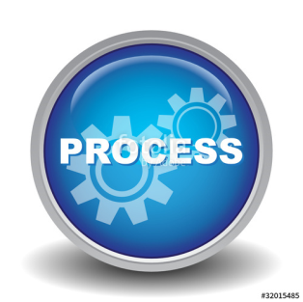
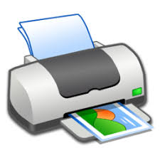

OS as Resource Manager
It is the job of OS to allocate these resources to the various applications so that:
The resources are allocated fairly (equally)
Wants to print 50 lines
P1
After printing 10 lines of P1
Wants to print 20 lines
P2
After printing 20 lines of P1
Wants to print 15 lines
P3
Wants to print 15 lines
P4

Slide 17
OS as Resource Manager
It is the job of OS to allocate these resources to the various applications so that:
The resources are protected from cross-access.
Wants to print 50 lines
P1
After printing 10 lines of P1
Wants to print 20 lines
P2
After printing 20 lines of P1
Wants to print 15 lines
P3
Wants to print 15 lines
P4

Slide 18

OS as Resource Manager
It is the job of OS to allocate these resources to the various applications so that:
Access to the resources is synchronized so that operations are correct and consistent
Example: If we write a program to calculate below in C language
7 + 9 – 6 * 4 / 2 = 4
P1
P2
P3
P4
20
3
4
1
2

Slide 19
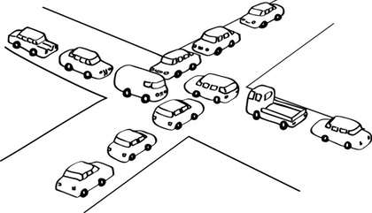
OS as Resource Manager
It is the job of OS to proper allocate these resources to the various applications so that:
Deadlock are detected, resolved and avoided.

Slide 20
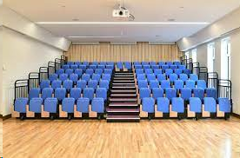
OS as Resource Manager
Resource manager – sharing resources in two different ways:
In space sharing
In time sharing

Slide 21
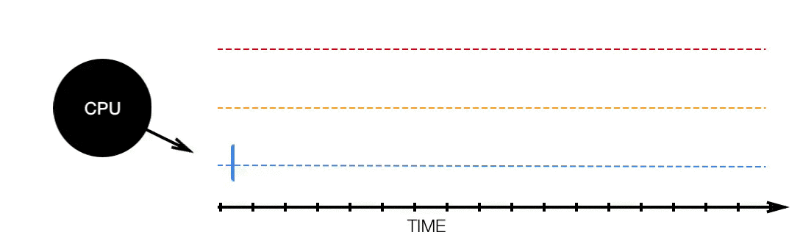
OS as Resource Manager
Resource manager – sharing resources in two different ways:
In time sharing/multiplexing (i.e CPU)

Slide 22
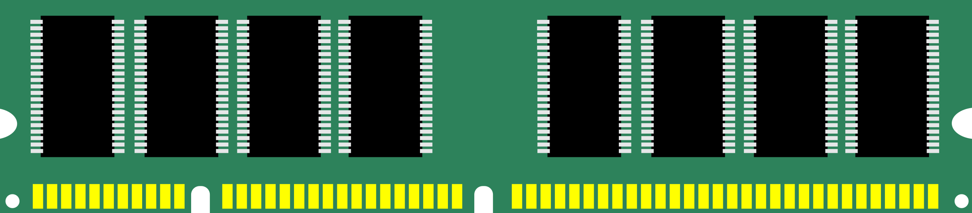
OS as Resource Manager
Resource manager – sharing resources in two different ways
In space sharing/multiplexing. (i.e Memory)
Process 1
Process
2
Process
3
Empty Space
Main Memory

Slide 23
Objectives / Goals of Operating System (OS)
Section - 3

Slide 24

Objectives / Goals of Operating System (OS)
Make the computer system convenient to use in an efficient manner.
Hide the details of the hardware resources from the users.
Provide users a convenient interface to use the computer system.
Act as an intermediary between the hardware and its users, making it easier for the users to access and use other resources.
Manage the resources of a computer system.
Keep track of who is using which resource, granting resource requests, and mediating conflicting requests from different programs and users.
Provide efficient and fair sharing of resources among users and programs.

Slide 25
Generations of Operating Systems (OS)
Section - 4

Slide 26
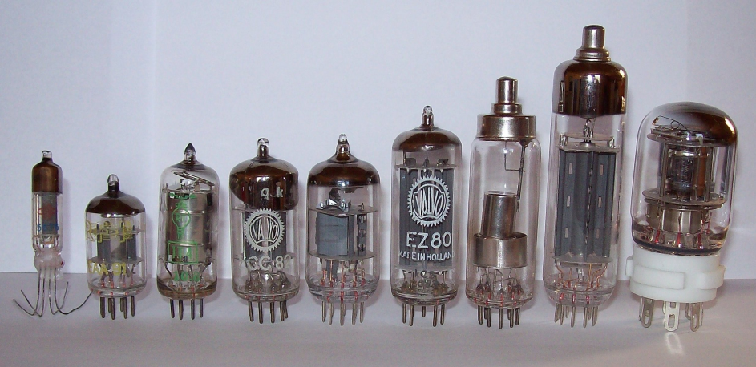
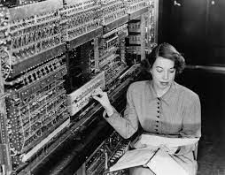
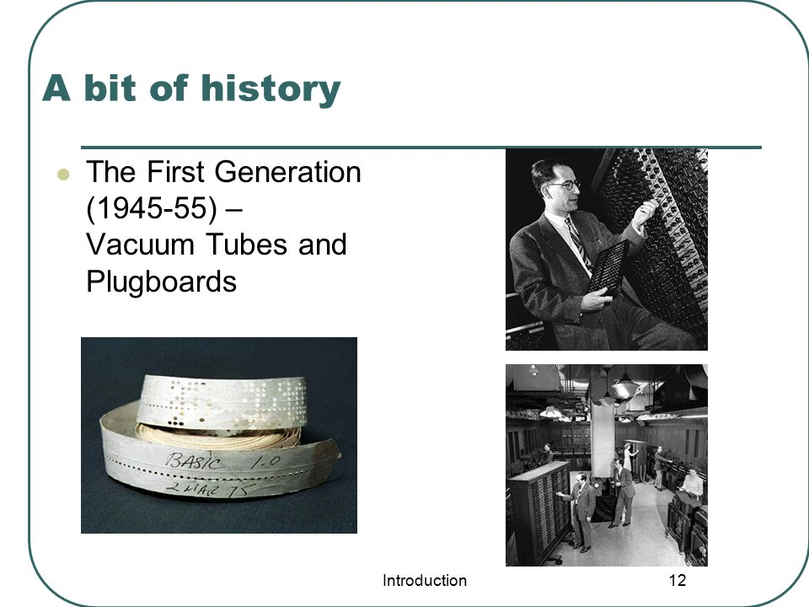
Generations / History of OS (First generation)
First generation (1945-1955)
Vacuum tubes and plug-boards are used in these systems.
Vacuum tubes
Plug board

Slide 27
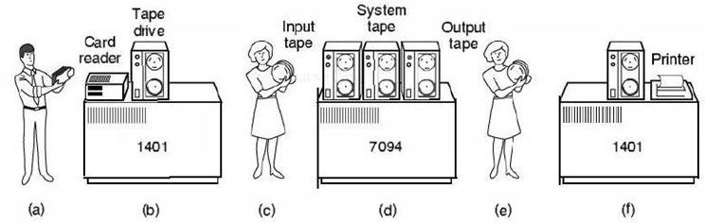
Generations / History of OS (Second generation)
Second generation (1955-1965)
Transistors are used in these systems
The machine that are produced are called mainframes.
Batch systems was used for processing.
Programmers bring cards to 1401
1401 reads batch of jobs onto tape
Operator carries input tape to 7094
7094 does computing
Operator carries output tape to 1401
1401 prints output

Slide 28
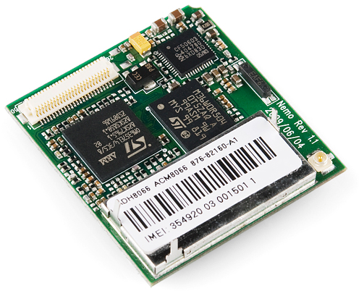
Generations / History of OS (Third generation)
Third generation (1965-1980)
Integrated circuits (IC's) are used in place of transistors in these computers.
It provides multiprogramming (the ability to have several programs in memory at once, each in its own memory partition).

Slide 29
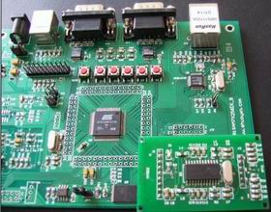
Generations / History of OS (Forth generation)
Fourth generation (1980-present)
Personal Computers (PC)
LSI (Large Scale Integration) circuits, chips containing thousands of transistors are used in these systems.

Slide 30
Operating Systems (OS) services
Section - 5

Slide 31

Services / Functions / Tasks of Operating System (OS)
Definition of Operating System
An Operating System (OS) is a collection of software that
manages hardware resources
provides various service to the users

Slide 32

Services / Functions / Tasks of Operating System (OS)
Program development
It provides editors and debuggers to assist (help) the programmer in creating programs.
Exercise
Give the name of any three code editor for windows?

Slide 33
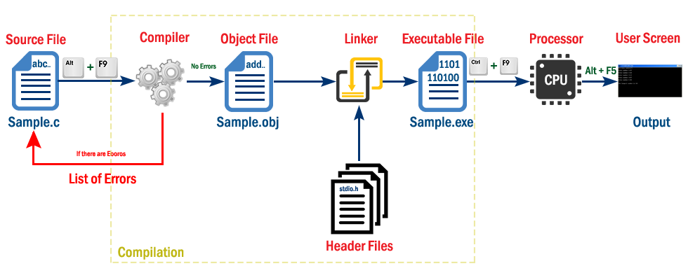
Services / Functions / Tasks of Operating System (OS)
Program execution
Following tasks need to be perform to execute a program:
Instructions and data must be loaded into main memory.
I/O devices and files must be initialized.
The OS handles all these duties for the user.

Slide 34
Services / Functions / Tasks of Operating System (OS)
Memory management
OS manages memory hierarchy.
OS keeps the track of which part of memory area in use and free memory.
It allocates memory to program when they need it.
It de-allocate the memory when the program finish execution.
P1
P2

Slide 35

Services / Functions / Tasks of Operating System (OS)
Access to I/O devices (Resource allocation)
A running program may require I/O, which may involve file or an I/O device.
For efficiency and protection, users cannot control I/O devices directly.
Therefore, the OS controls these I/O devices and provides to program as per requirement.

Slide 36
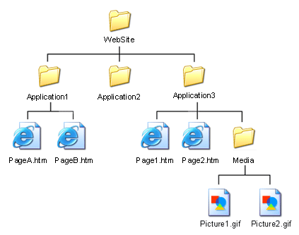
Services / Functions / Tasks of Operating System (OS)
Controlled access to file
In case of file access, OS provides a directory hierarchy for easy access and management of file.
OS provides various file handling commands using which user can easily read, write and modify file.

Slide 37
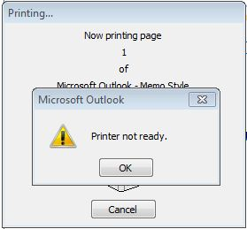
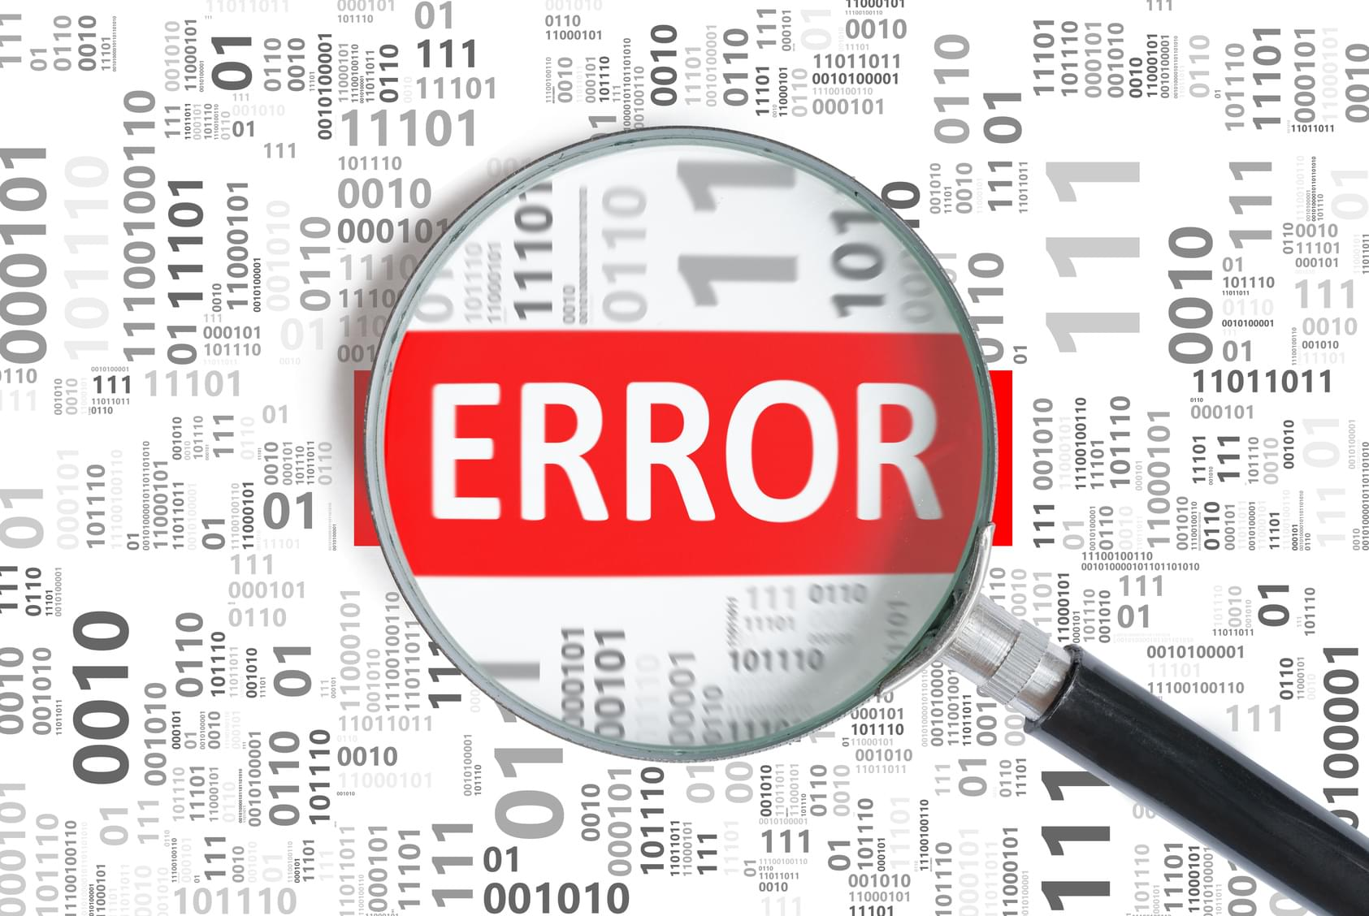
Services / Functions / Tasks of Operating System (OS)
Error detection and response
An error may occur in CPU, in I/O devices or in the memory hardware.
Following are the major activities of an operating system with respect to error handling −
The OS constantly checks for possible errors.
The OS takes an appropriate action to ensure correct and consistent computing.

Slide 38
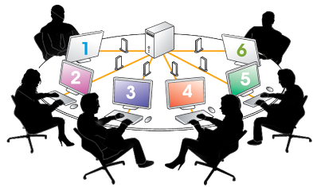
Services / Functions / Tasks of Operating System (OS)
Accounting
Keeping a track of which users are using how much and what kinds of computer resources can be used for accounting or simply for accumulating usage statistics.
Usage statistics is used to reconfigure the system to improve computing services.

Slide 39
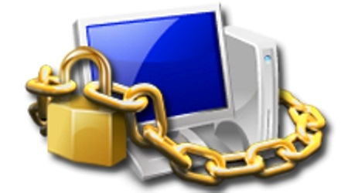
Services / Functions / Tasks of Operating System (OS)
Protection & Security
Protection involves ensuring that all accesses to system resources is controlled.
To make a system secure, the user needs to authenticate himself or herself to the system.

Slide 40
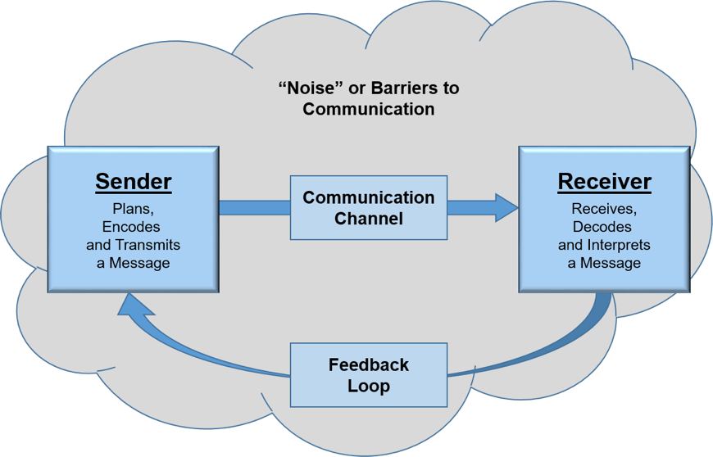
Services / Functions / Tasks of Operating System (OS)
Communication
In multitasking environment, the processes need to communicate with each other and to exchange their information.
Operating system performs the communication among various types of processes in the form of shared memory.

Slide 41
Types of Operating Systems (OS)
Section - 6

Slide 42
Types of Operating Systems (OS)
Mainframe operating systems
OS found in room sized computers which are still found in major corporate data centers.
They offer three kinds of services:
Batch OS
Transaction processing
Timesharing
Examples: OS/390, OS/360.

Slide 43
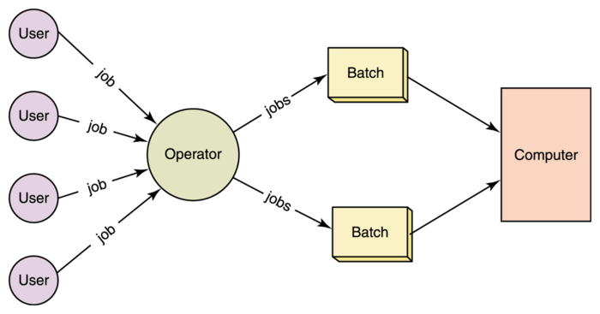
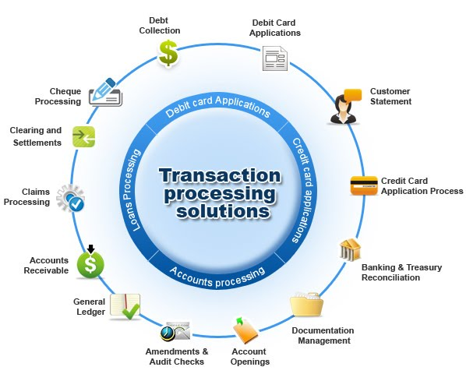
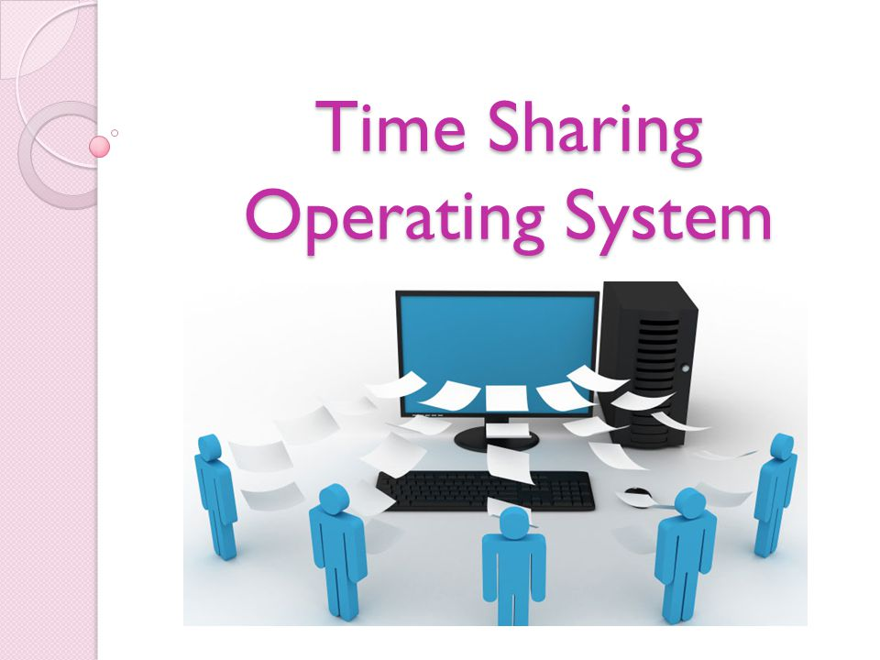
Mainframe Operating Systems services
Batch OS – processes routine jobs without any interactive user presents i.e. payroll systems, bank statements
Transaction processing – handles large numbers of small processes i.e. cheque processing at banks
Timesharing – allows multiple remote users to run their jobs at once i.e. querying a database, airline booking system

Slide 44
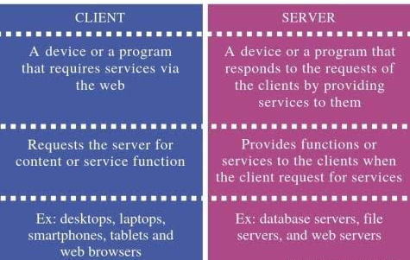
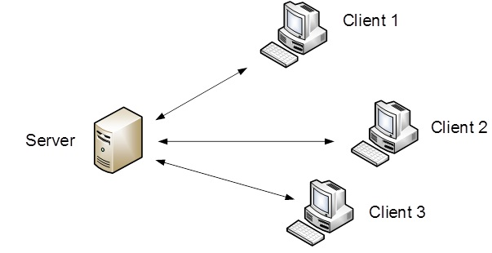
Types of Operating Systems (OS)
Server operating systems
This OS runs on servers which are very large PC, workstations or even mainframes.
They serve multiple users at once over a network and allow the users to share hardware & software resources.
It provides print services, file service or web service.
It handles the incoming requests from clients.
Examples: Solaris, FreeBSD, and Linux and Windows Server 200x.

Slide 45
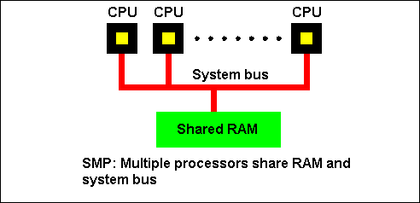
Types of Operating Systems (OS)
Multiprocessor operating systems
A computer system consist two or more CPUs is called multiprocessor.
It is also called parallel computers, multicomputer or multiprocessor.
They need special OS or some variations on server OS with special features for communication, connectivity and consistency.
Examples: Windows and Linux.

Slide 46
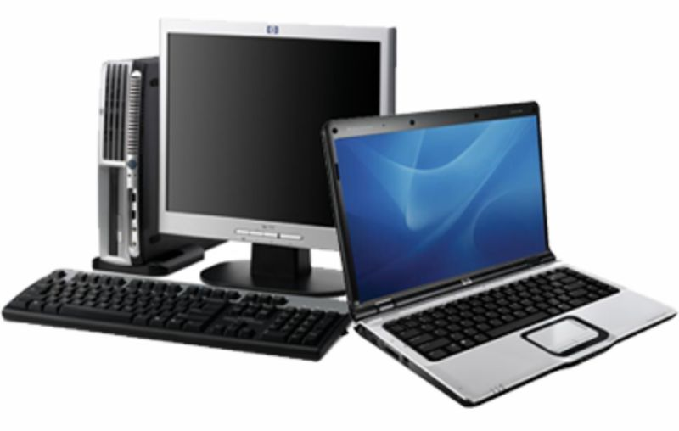
Types of Operating Systems (OS)
Personal computer operating systems
The operating systems installed on our personal computer and laptops are personal OS.
Job of this OS is to provide good support to single user.
This OS is widely used for word processing, spreadsheet and internet access.
Examples: Linux, Windows vista and Macintosh.

Slide 47
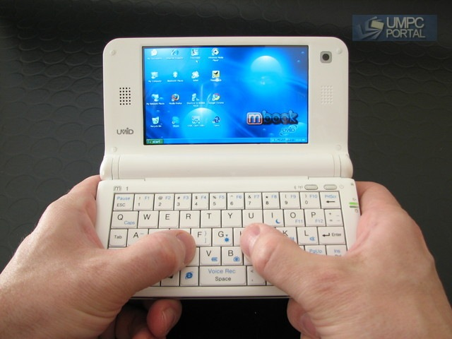
Types of Operating Systems (OS)
Handhelds computer operating systems
A handheld computer or PDA (Personal Digital Assistant) is small computer that fit in a Pocket and perform small number of functions such as electronic address book, memo pad.
The OS runs on these devices are handheld OS.
These OS also provides ability to handle telephony, digital photography and other functions.
Examples: Symbian OS, Palm OS.

Slide 48
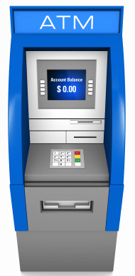
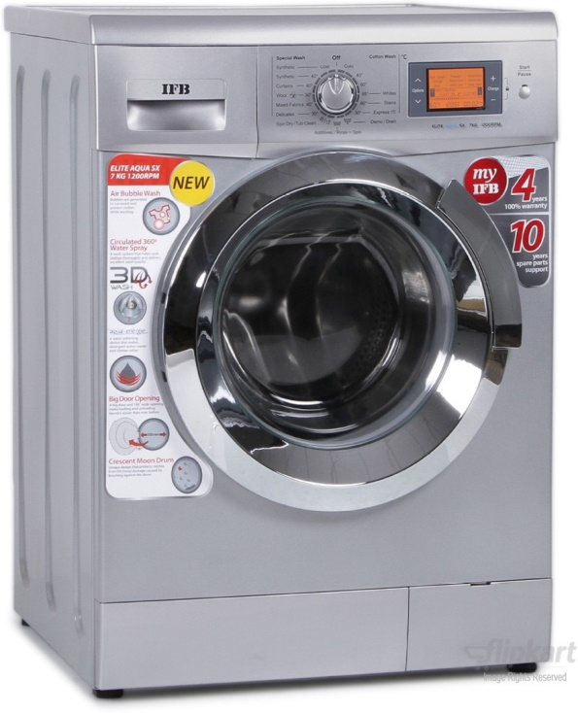
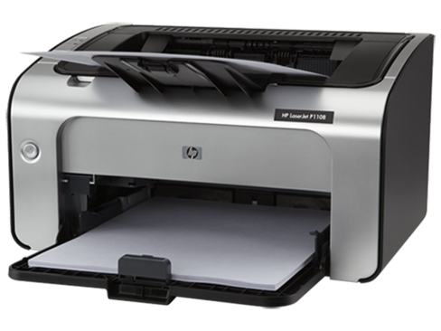
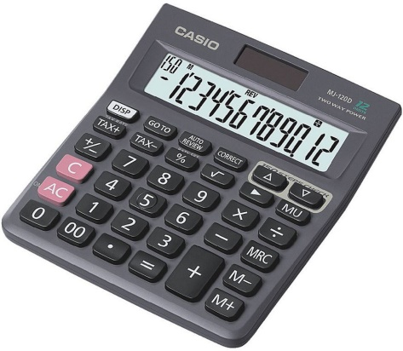
Types of Operating Systems (OS)
Embedded operating systems
This OS is installed in ATMs, printers, calculators and washing machine.
It runs on the computer that control devices.
It neither allow to download new software nor accept user installed software. So there is no need for protection.
Examples: QNX, VxWorks.

Slide 49
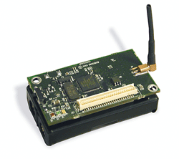
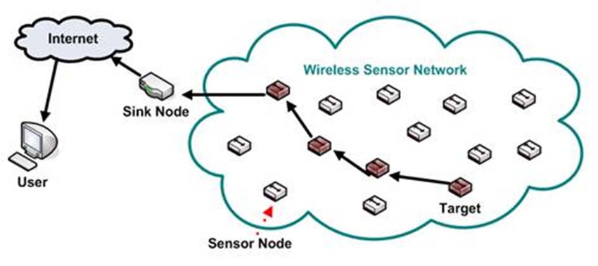
Types of Operating Systems (OS)
Sensor node operating systems
Network of tiny sensor nodes are being developed for numerous purpose.
Each nodes are tiny computers with a CPU, RAM, ROM and one or more environmental sensors.
The OS installed in these nodes are sensor node OS.
They communicate with each other and with base station using wireless communication.
These sensor network are used to protect area of building, detect fires in forest, measure temperature.
Examples: TinyOS.

Slide 50
Types of Operating Systems (OS)
Real time operating systems
These systems having time as a key parameter.
Real time OS has well defined fixed time constraints.
Processing must be done within defined time constraints otherwise system fails.
Two types of real time OS:
Hard real time – missing an occasional deadline can cause any permanent damage such as human injury or equipment damage. Many of these are found in industrial process control, car engine control system.
Soft real time – missing an occasional deadline does not cause any permanent damage. Used in digital audio, multimedia system.
Examples: e-Cos.

Slide 51

Types of Operating Systems (OS)
Smart card operating systems
Smallest OS run on smart cards which are credit card sized devices containing CPU chip.
These OS are installed on electronic payments cards such as debit card, credit card etc.
They have limited processing power.
Some smart cards are Java oriented. ROM on smart card holds an interpreter for the JVM – small program.

Slide 52
System calls
Section - 7

Slide 53
What is System calls?
A system call is a way for programs to interact with the operating system.
A system call is a mechanism that provides the interface between a process and the operating system.
A computer program makes a system call when it makes a request to the operating system's kernel.
It is a programmatic method in which a computer program requests a service from the kernel of the OS.
System call provides the services of the operating system to the user programs via Application Program Interface(API).
System calls are the only entry points for the kernel system.
Web
browser
E-mail
reader
Music
player
User
Mode
User Program
Software
Operating System
Kernel
Mode
Hardware

Slide 54
Types of system calls
Process Control: This system calls perform the task of process creation, process termination, etc.
Functions:
End and abort
Load and execute
Create process and terminate process
Wait and signed event
Allocate and free memory
File Management: File management system calls handle file manipulation jobs like creating a file, reading, and writing, etc.
Functions:
Create a file
Delete file
Open and close file
Read, write and reposition
Get and set file attributes

Slide 55
Types of system calls
Device Management: Device management does the job of device manipulation like reading from device buffers, writing into device buffers, etc.
Functions
Request and release device
Logically attach/ detach devices
Get and Set device attributes
Information Maintenance: It handles information and its transfer between the OS and user program.
Functions:
Get or set time and date
Get process and device attributes

Slide 56
Types of system calls
Communication: These types of system calls are specially used for interprocess communications (IPC).
Functions:
Create, delete communications connections
Send, receive message
Help OS to transfer status information
Attach or detach remote devices

Slide 57

System calls

Slide 58

System calls

Slide 59
Example of system calls (Read system call)
Example: In Unix Read system call is
count = read(fd, buffer, nbytes)
fd is a file descriptor.
When a file is opened, permissions are checked.
If access is allowed, a number (fd) is returned.
Then file can be read/written.
nbytes is number of bytes to read
buffer is where read deposits (stores) the data
Return to caller
Library
procedure
read
Trap to the kernel
5
Put code for read in register
6
10
User
space
Call to library proc
4
11
Increment SP
Call read
User
program
calling read
3
Push fd
Push parameter onto stack
2
Push &buffer
9
1
Push nbytes
Kernel
space
7
8
Dispatch
Sys call
handler

Slide 60
Steps involved in making a system call (Read system call)
Steps involved in making a system call
In steps 1-3, the calling program pushes the parameters onto the stack. The first and third parameters are called by value, but the second one is called by its address as denoted by the & symbol.
In step 4, the actual call to the library procedure is made. This instruction is the normal procedure call instruction used to call all procedures.
In step 5, the library procedure places the system call number in a place where the operating system expects it, such as a register.
In step 6, the library procedure executes a TRAP instruction to switch from user mode to kernel mode and start execution at a fixed address within the kernel.
In step 7, the kernel examines the system call number and then dispatches it to the correct system call handler. This correct number is given in the table of system call handlers by pointers referenced at the system call number.
In step 8, the system call handler runs.
In step 9, the operation is completed, and the user is given back control once the TRAP instruction is set.
In step 10, this procedure returns to the user program, like how all normal library procedures do.
In step 11, the operating system has to clear the stack, so it increments it enough so that it is empty.

Slide 61
Operating Systems (OS) structure
Section - 8

Slide 62
Operating Systems (OS) structure
Monolithic systems
Layered systems
Microkernel
Client-server model
Virtual machines
VM/370
Virtual machines rediscovered
The java virtual machine

Slide 63
Monolithic systems
The entire OS runs as a single program in kernel mode.
OS is written as a collection of procedures, linked together into a single large executable binary program.
Each procedure has well defined interface in terms of parameter and results, and each one is free to call any other one.
A main program that invoke the requested service procedure.
A set of service procedures that carry out the system calls.
A set of utility procedures that help the service procedure.
Main
Procedure
Service
Procedures
Utility
Procedure
Linux uses the monolithic system

Slide 64
Layered systems
In this system, the OS is organized as a hierarchy of layers.
The first system constructed in this way was THE system.
Layer | Function | Description
5 | Operator | Operator was located.
4 | User programs | User programs were found.
3 | Input / Output management | Takes care of managing the I/O devices. Buffering the information.
2 | Operator-process communication | Handles communication between each process and the operator console (i.e. user).
1 | Memory and drum management | Did the memory management. Allocated space for process in main memory and on a 512K word drum used for holding parts of processes for which there was no room in memory.
0 | Processor allocation and multi-programming | Provided the basic multiprogramming of the CPU. Dealt with allocation of the processor, switching between processes when interrupts occurred or timers expired.

Slide 65

Microkernel
In layered approach, the designer have choice where to draw the kernel and user mode boundary.
It is better to put as little as possible in kernel mode because bugs in the kernel can bring down the system instantly.
The microkernel design provides high reliability by splitting OS up into small well defined modules, only one module run in kernel and rest of all run in user mode.
As each device driver runs as a user process, a bug in audio driver will cause the sound to be stop, but not crash the computer.
Examples: Integrity, K42, QNX, Symbian and MINIX 3.
Kernel contains only
Sys (Kernel call handler)
Clock (because scheduler interact with it)
Windows uses the microkernel

Slide 66

Client-Server model
Processes are divided into two categories
Servers: provide services
Clients: uses services
Client and server run on different computers, connected by LAN or WAN and communicate via message passing.
To obtain a service, a client construct a message saying what it wants and send it to server.
The server then does the work and send back the answer.

Slide 67




Virtual machines
A virtual machine is like a computer inside your computer.
It's not a real machine you can touch, but a pretend one created by software.
This lets you run different operating systems or software on your computer without needing a separate physical machine for each.
The software that enables virtualization is called a hypervisor or Virtual Machine Monitor (VMM).
The hypervisor sits between the hardware and the virtual machines, managing the allocation of resources and providing a virtualized environment for each VM.
Types of Virtual machines are:
VM/370
Virtual Machines Rediscovered
The Java Virtual Machine

Slide 68
Multiprogramming v/s Multiprocessing v/s Multitasking
Section - 9

Slide 69





Multiprogramming v/s Multiprocessing v/s Multitasking
Multiprogramming
Multiprocessing
Multitasking

Slide 70
Multiprogramming v/s Multiprocessing v/s Multitasking
Multiprogramming | Multiprocessing | Multitasking
The concurrent residency of more than one program in the main memory is called as multiprogramming. | The availability of more than one processor per system, which can execute several set of instructions in parallel is called as multiprocessing | The execution of more than one task simultaneously is called as multitasking.
Number of processor: one | Number of processor: more than one | Number of processor: one
One process is executed at a time. | More than one process can be executed at a time. | One by one job is being executed at a time.
Multitasking is a logical extension of multi programming. The major way in which multitasking differs from multi programming is that multi programming works solely on the concept of context switching whereas multitasking is based on time sharing alongside the concept of context switching.

Slide 71
Time Sharing Operating System
Section - 10

Slide 72


Time Sharing Operating System
A time sharing operating system allows many users to share the computer resources simultaneously.
The CPU time is divided into small intervals, or time slices, and each user is given a small portion of time during which their program or task can execute.

Slide 73
Parallel Processing Operating System
Section - 11

Slide 74
Parallel Processing Operating System
Parallel Processing Operating Systems are designed to speed up the execution of programs by dividing the program into multiple fragments and processing these fragments simultaneously.
Such systems are multiprocessor systems.
Parallel systems deal with the simultaneous use of multiple computer resources that can include a single computer with multiple processors.
Multiprocessing

Slide 75
Distributed Operating System
Section - 12

Slide 76


Distributed Operating System
A distributed operating system is an operating system that runs on multiple machines and enables them to work together as a single, integrated system.
A distributed operating system is an extension of the network operating system that supports higher levels of communication and integration of the machines on the network.

Slide 77
IMP Questions
What is operating system? Differentiate Monolithic Kernel and Micro Kernel.
Explain different service/functions provided by operating system.
Discuss role of OS as a resource manager.
Explain different types of operating system.
What is operating system? Give the view of OS as an extended machine.
What is system call? Explain steps for system call execution.
List out types of operating system and explain batch OS and time sharing OS in brief.
Differentiate multi programing, multi processing and multi tasking.
Explain time sharing OS, parallel processing OS and distributed OS.

Slide 78
Operating Systems (OS)
2101CS403
Prof. Firoz A Sherasiya
Computer Engineering Department
firoz.sherasiya@darshan.ac.in
9879879861

